Slide 1
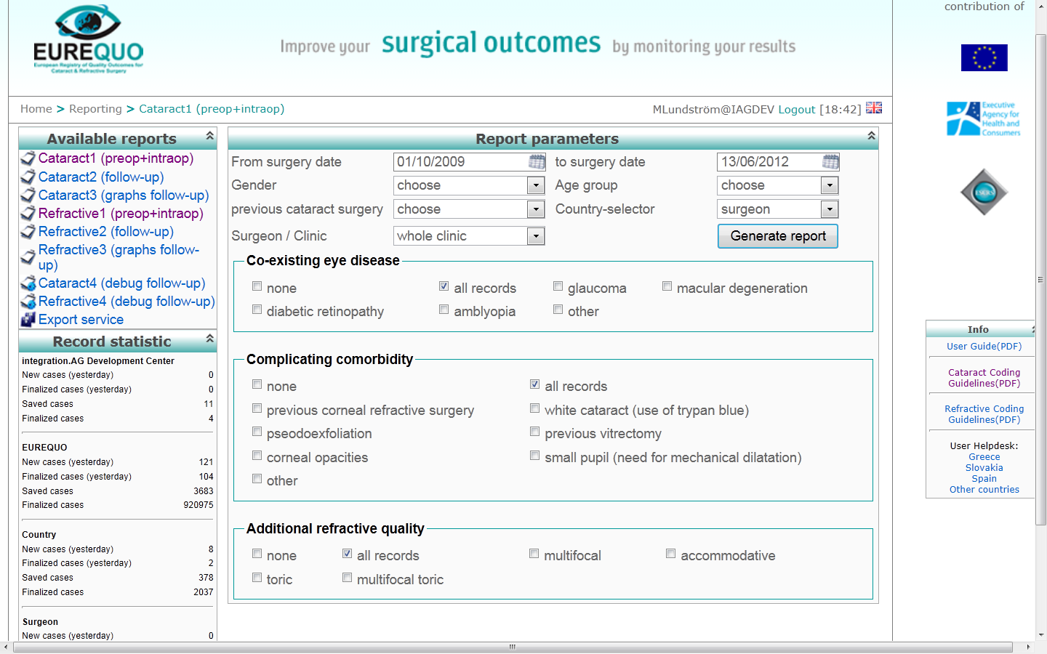

Slide 2
Take out a report
Cataract or Refractive?
Preop. table, Postop. table or graph?
Whose data?
Which period?
Any demographic selection?
What kind of surgery (refractive)?
Selection on co-morbidity or difficulty?

Slide 3
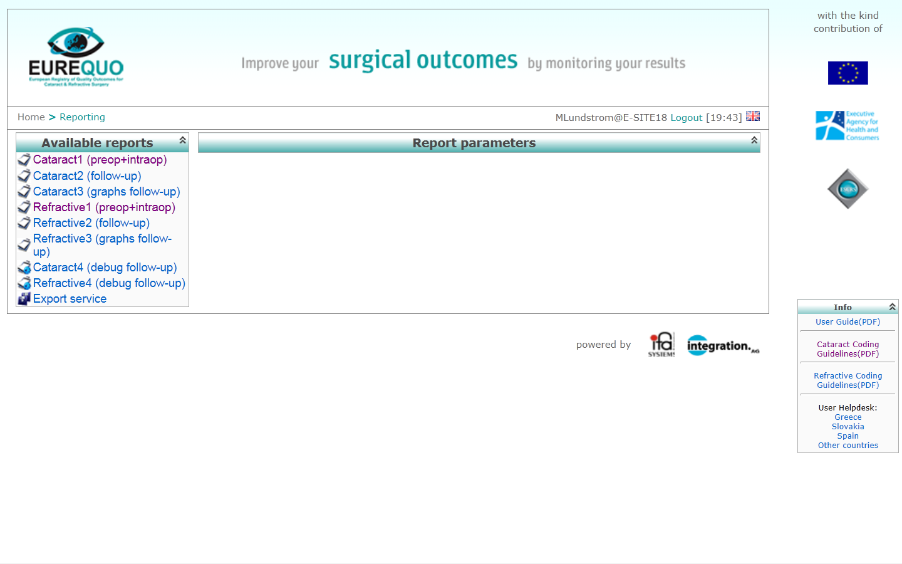
Type of surgery
Type of report

Slide 4
Take out a report
Cataract or Refractive?
Preop. table, Postop. table or graph?
Whose data?
Which period?
Any demographic selection?
What kind of surgery (refractive)?
Selection on co-morbidity or difficulty?

Slide 5
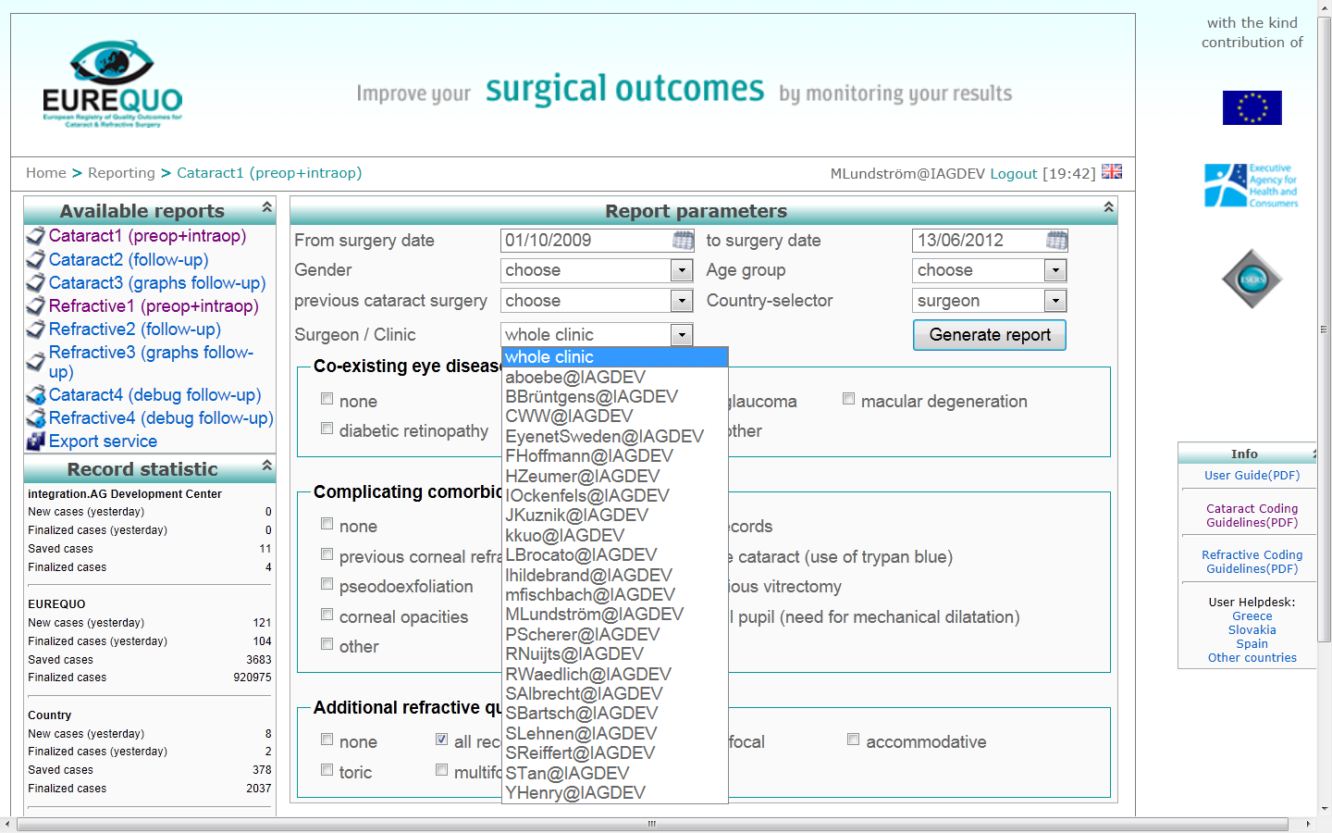
Clinic or surgeon

Slide 6
Take out a report
Cataract or Refractive?
Preop. table, Postop. table or graph?
Whose data?
Which period?
Any demographic selection?
What kind of surgery (refractive)?
Selection on co-morbidity or difficulty?

Slide 7
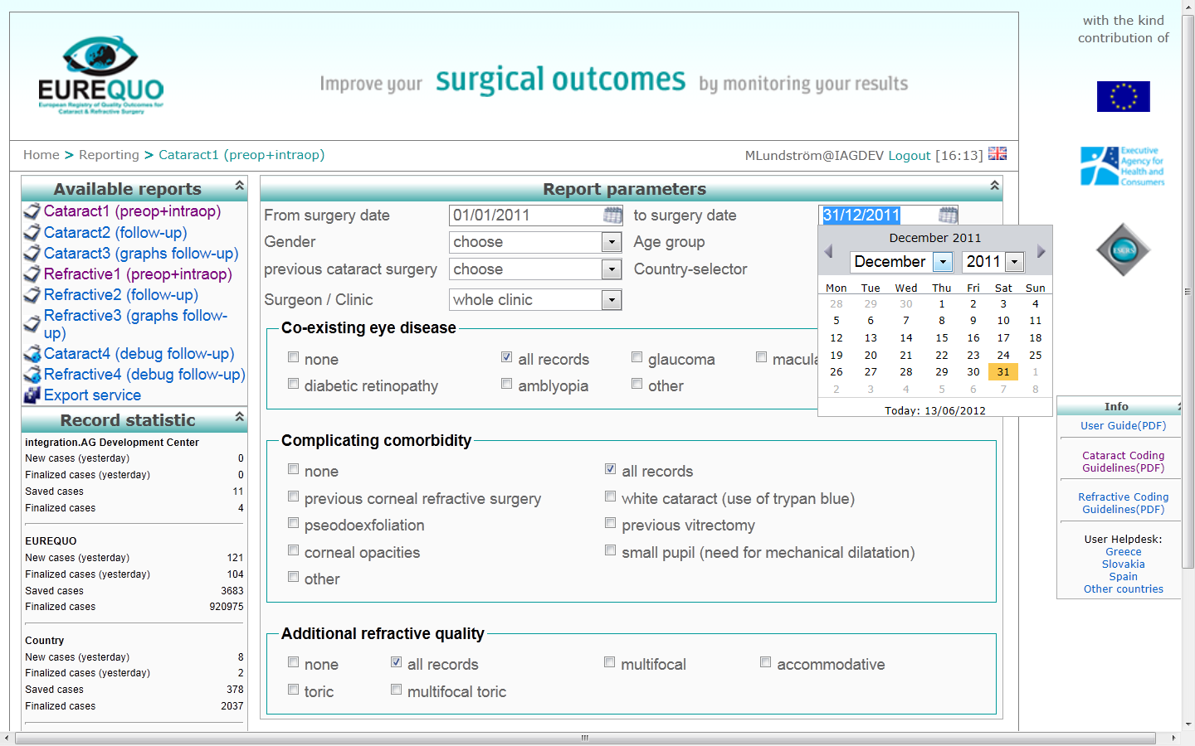
Time period

Slide 8
Take out a report
Cataract or Refractive?
Preop. table, Postop. table or graph?
Whose data?
Which period?
Any demographic selection?
What kind of surgery (refractive)?
Selection on co-morbidity or difficulty?

Slide 9
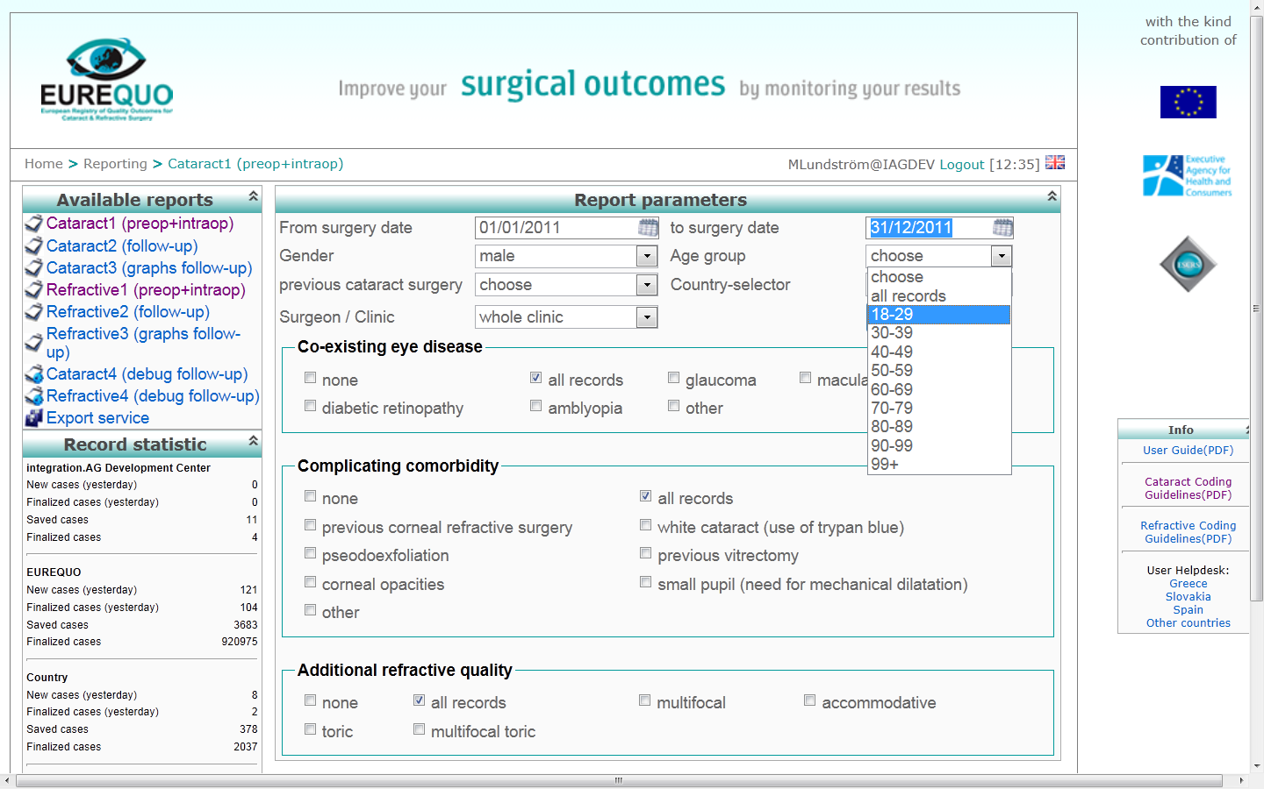
Selection on demography?

Slide 10
Take out a report
Cataract or Refractive?
Preop. table, Postop. table or graph?
Whose data?
Which period?
Any demographic selection?
What kind of surgery (refractive)?
Selection on co-morbidity or difficulty?

Slide 11
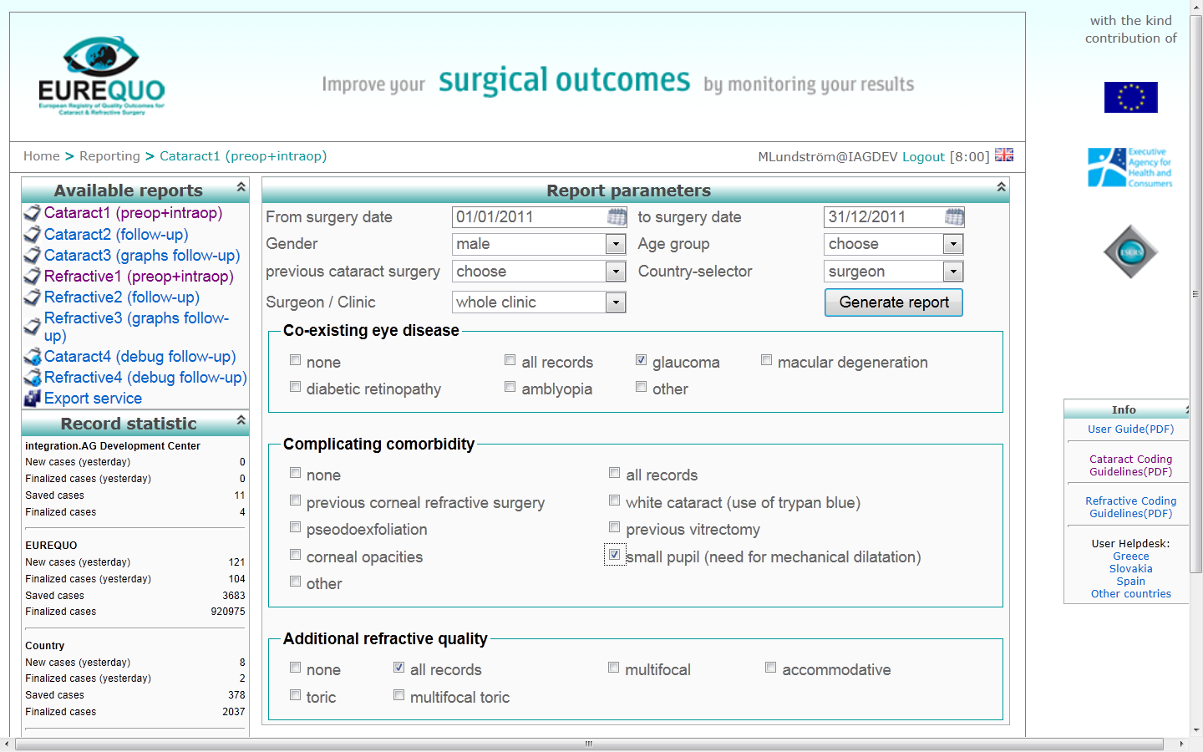
Selection on co-existing eye disease or surgical difficulty

Slide 12
Take out a report
Cataract or Refractive?
Preop. table, Postop. table or graph?
Whose data?
Which period?
Any demographic selection?
What kind of surgery (refractive)?
Selection on co-morbidity or difficulty?

Slide 13
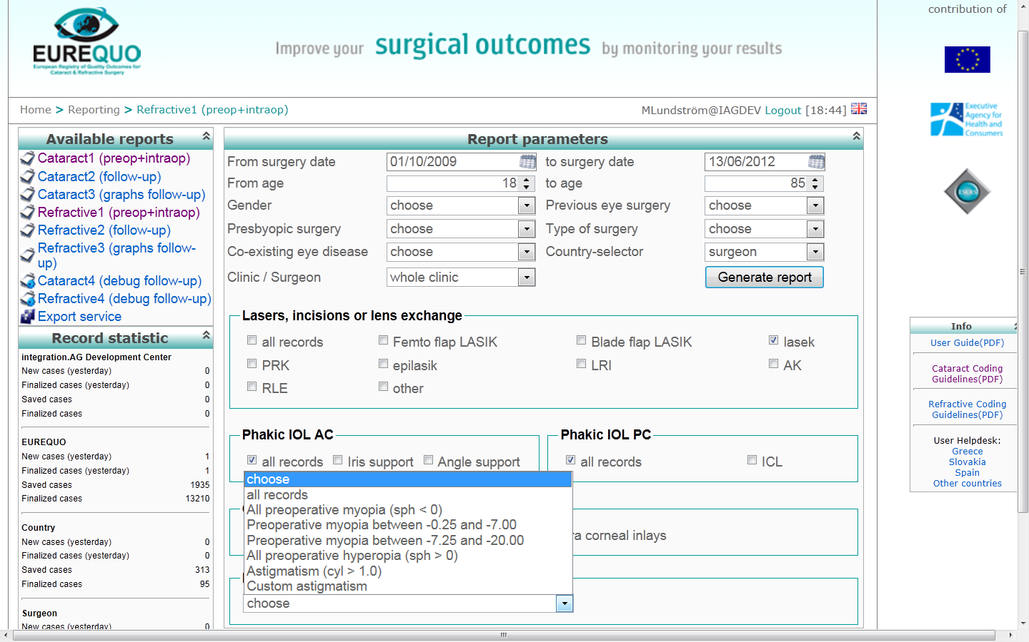
Type of surgery and preoperative refraction

Slide 14
Reports (output) via the web
Standard reports with selections
Data for surgeon, country and total database

Slide 15
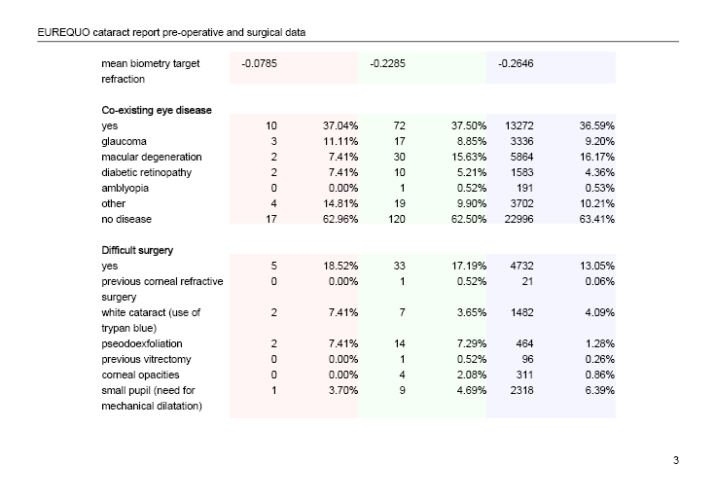
Ocular co-morbidity and difficult surgery

Slide 16
Post-operative BCVA ≥ 0.5 surgery eye, in %
All patients Patients with no ocular co-morbidity

Slide 17
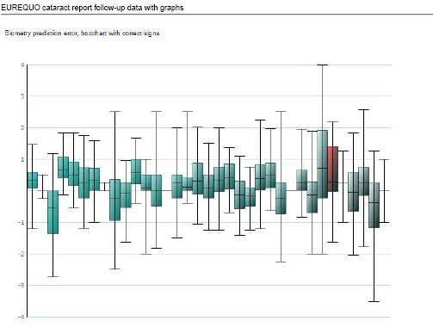

Slide 18
Capsule complication in %. Each box = one clinic

Slide 19
Operation method
Preoperative myopia

Slide 21
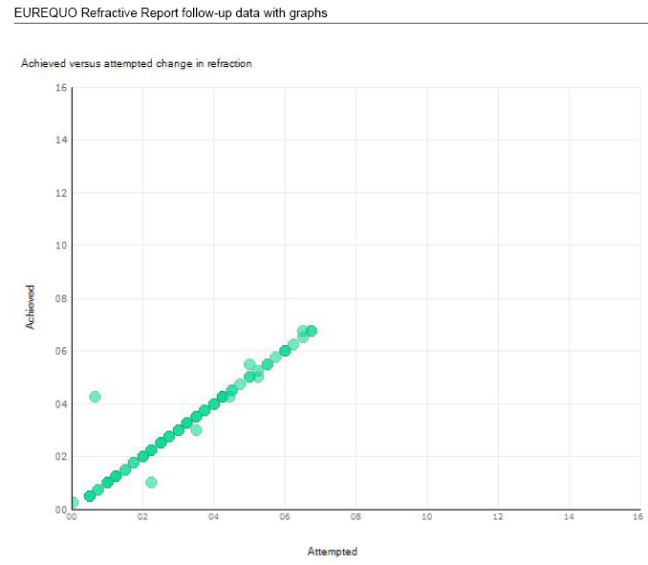
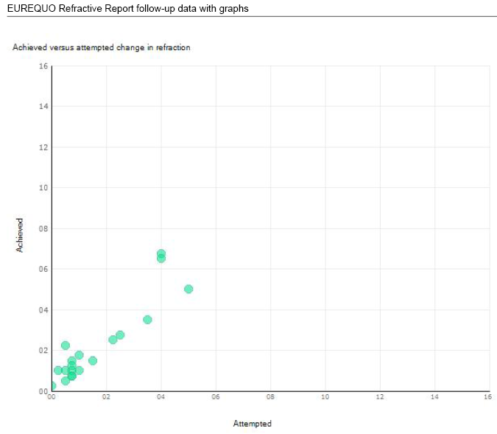
Attempted vs achieved refraction
Lasik, myopic patients – Lasik, hyperopic patients

